Slide 1

LSTM 2 on MNIST - use_peepholes

Slide 2
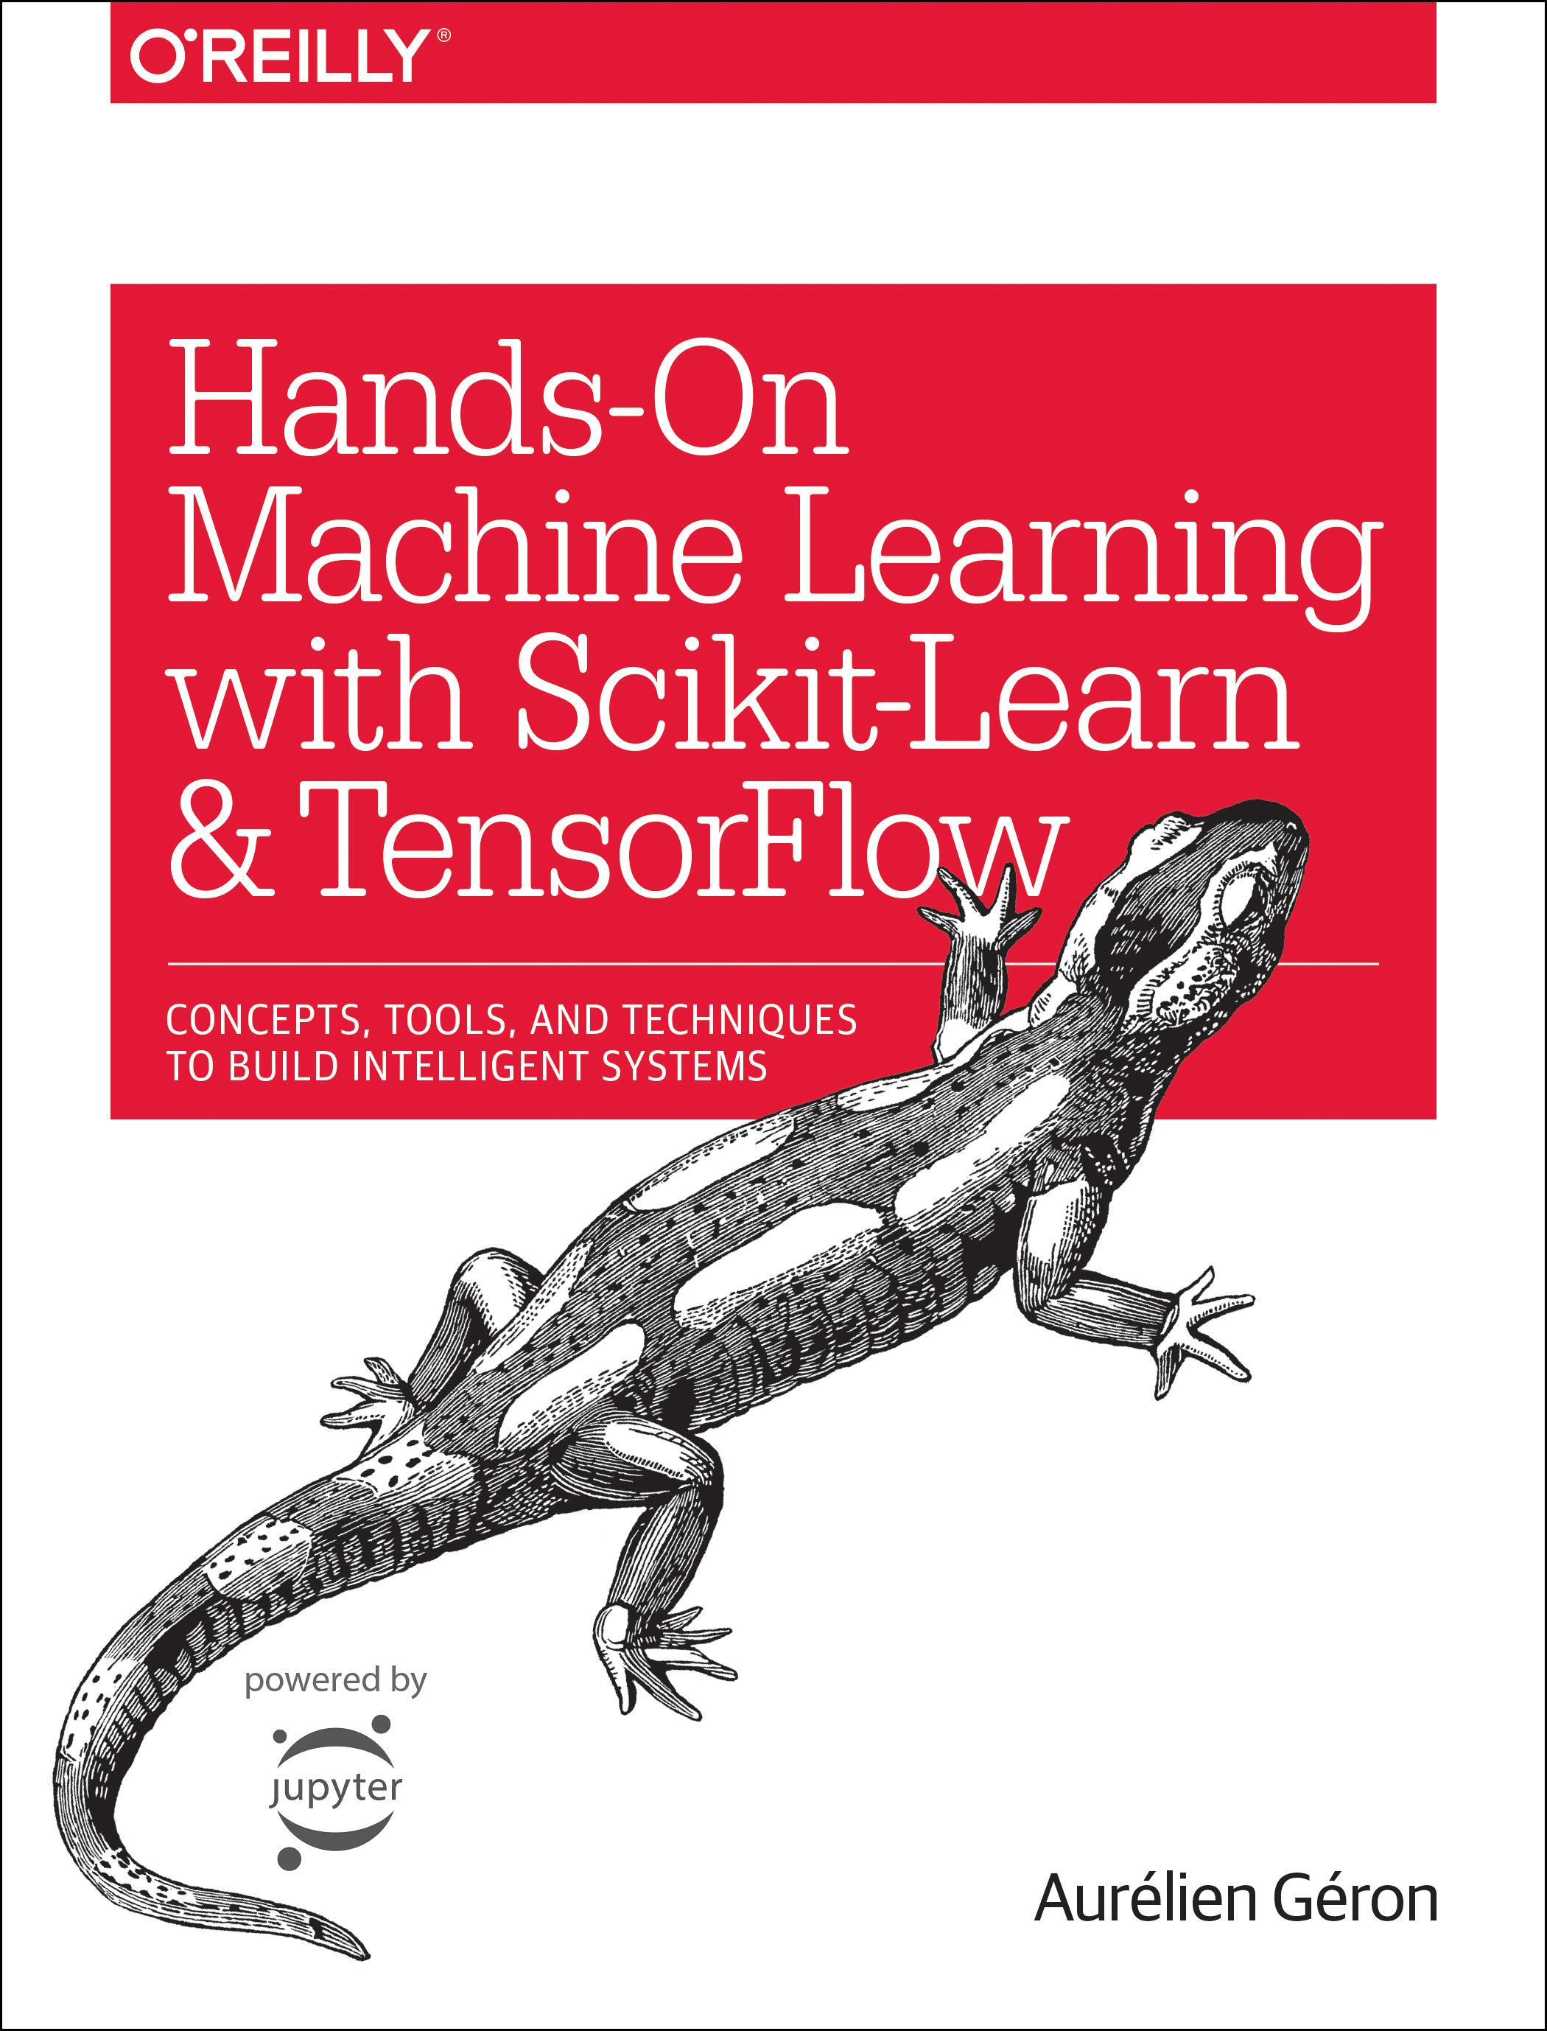
Reference
Chapter 14 (O'Reilly) of Hands-On ML
Youtube on MNIST
Youtube on CNN on MNIST
Youtube on RNN on MNIST
Youtube on LSTM on MNIST
Youtube
Code

Slide 3
Data

Slide 4
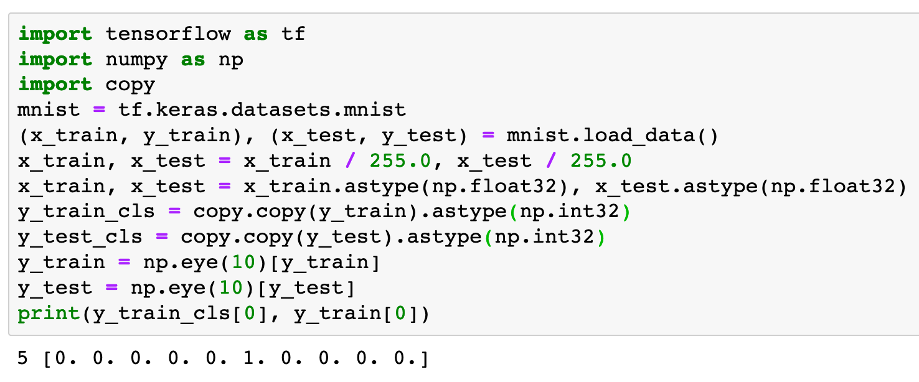

Slide 5
Warm Up

Slide 6
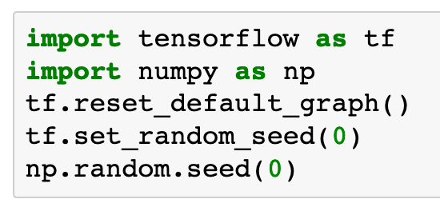

Slide 7
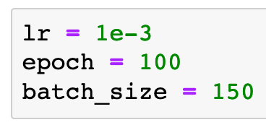

Slide 8
Graph

Slide 9
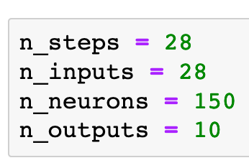

Slide 10
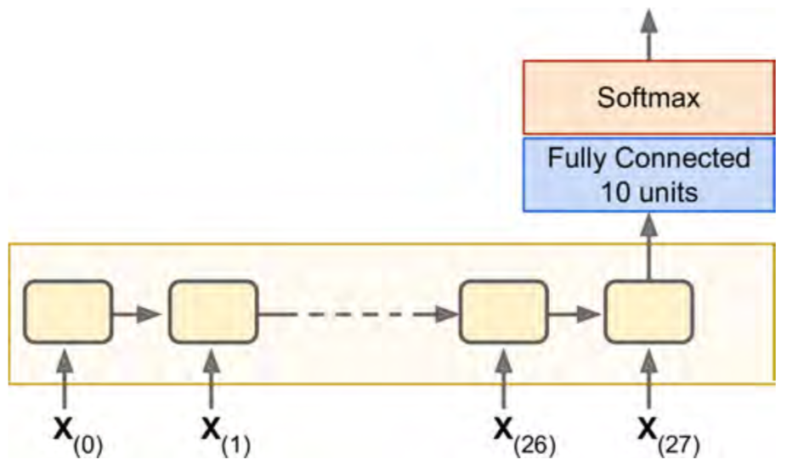
Chapter 14 (O'Reilly) of Hands-On ML

Slide 11


Chapter 14 (O'Reilly) of Hands-On ML

Slide 12

Chapter 14 (O'Reilly) of Hands-On ML

Slide 13
Chapter 14 (O'Reilly) of Hands-On ML

Slide 14
Chapter 14 (O'Reilly) of Hands-On ML

Slide 15

Chapter 14 (O'Reilly) of Hands-On ML

Slide 16
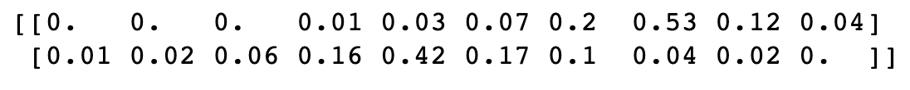
Chapter 14 (O'Reilly) of Hands-On ML

Slide 17
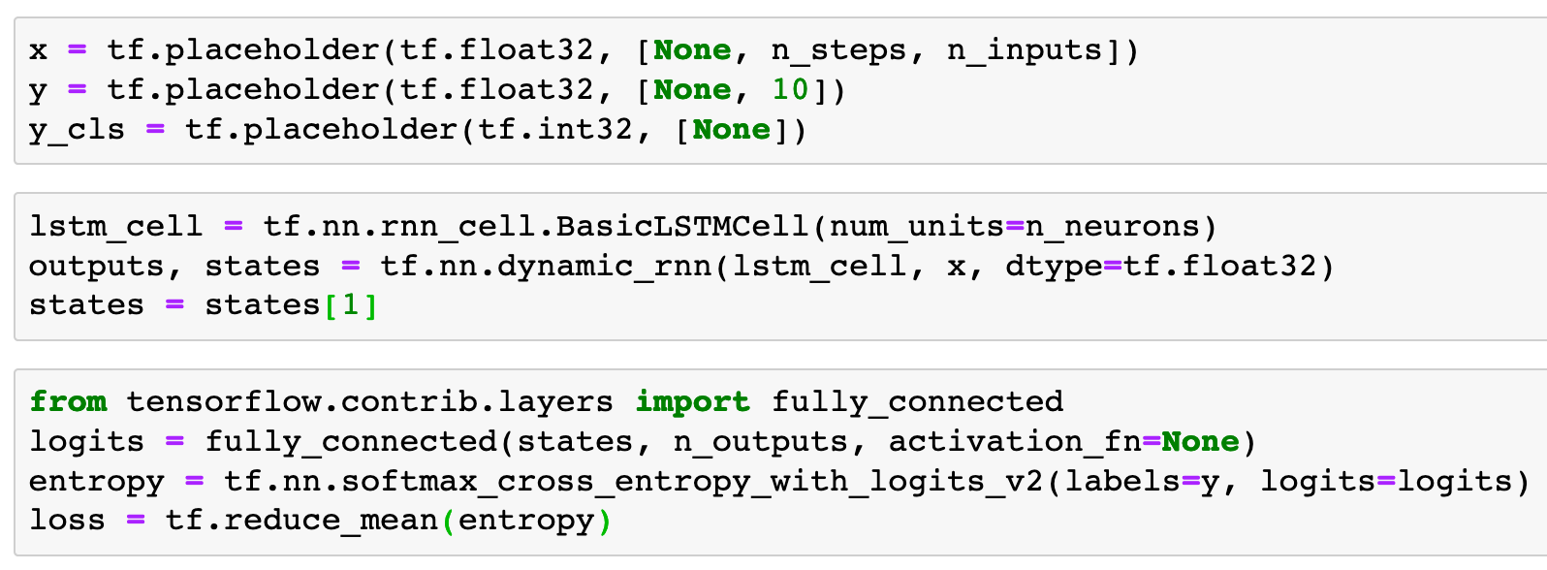
Previously in LSTM

Slide 18
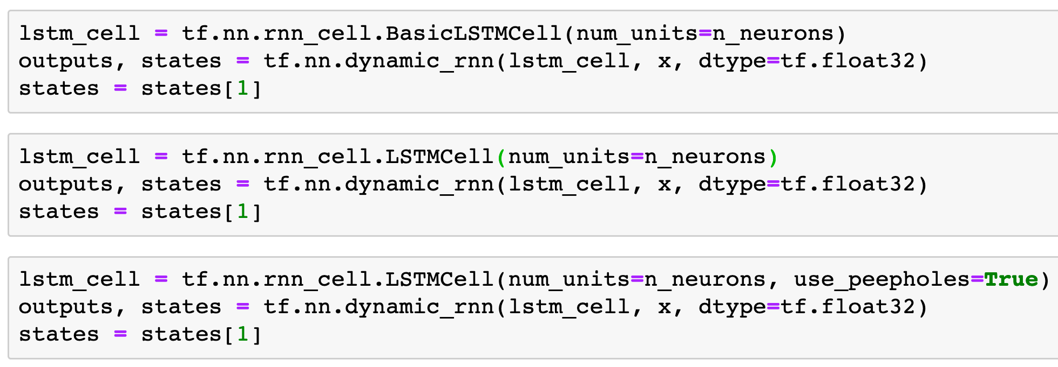

Previously
Without peephole
With peephole

Slide 19
Previously
Without peepholes
With peephole

Slide 20
Previously
Without peepholes
With peepholes

Slide 21
Previously
Without peepholes
With peepholes

Slide 22
Previously
Without peepholes
With peepholes

Slide 23
Previously
Without peepholes
With peepholes

Slide 24
Previously
Without peepholes
With peepholes

Slide 25
Previously
Without peepholes
With peepholes
Note

Slide 26
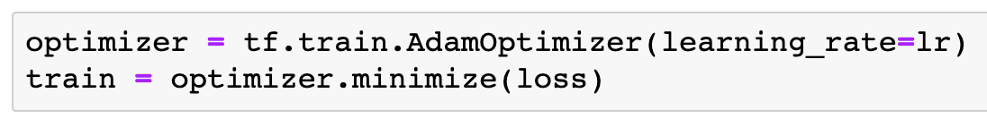

Slide 27
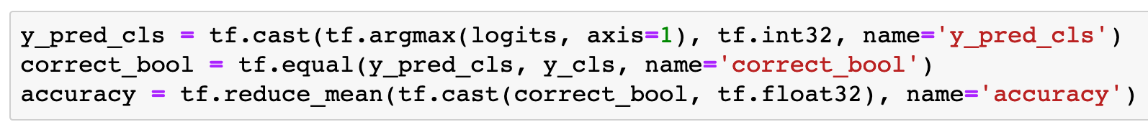

Slide 28
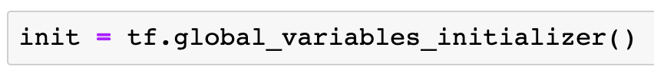

Slide 29
Session

Slide 30
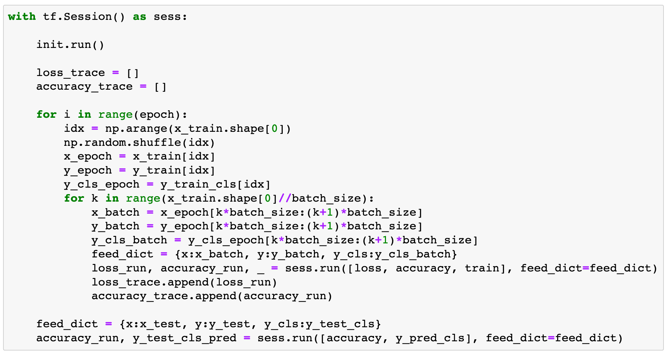

Slide 31
Report Result

Slide 32
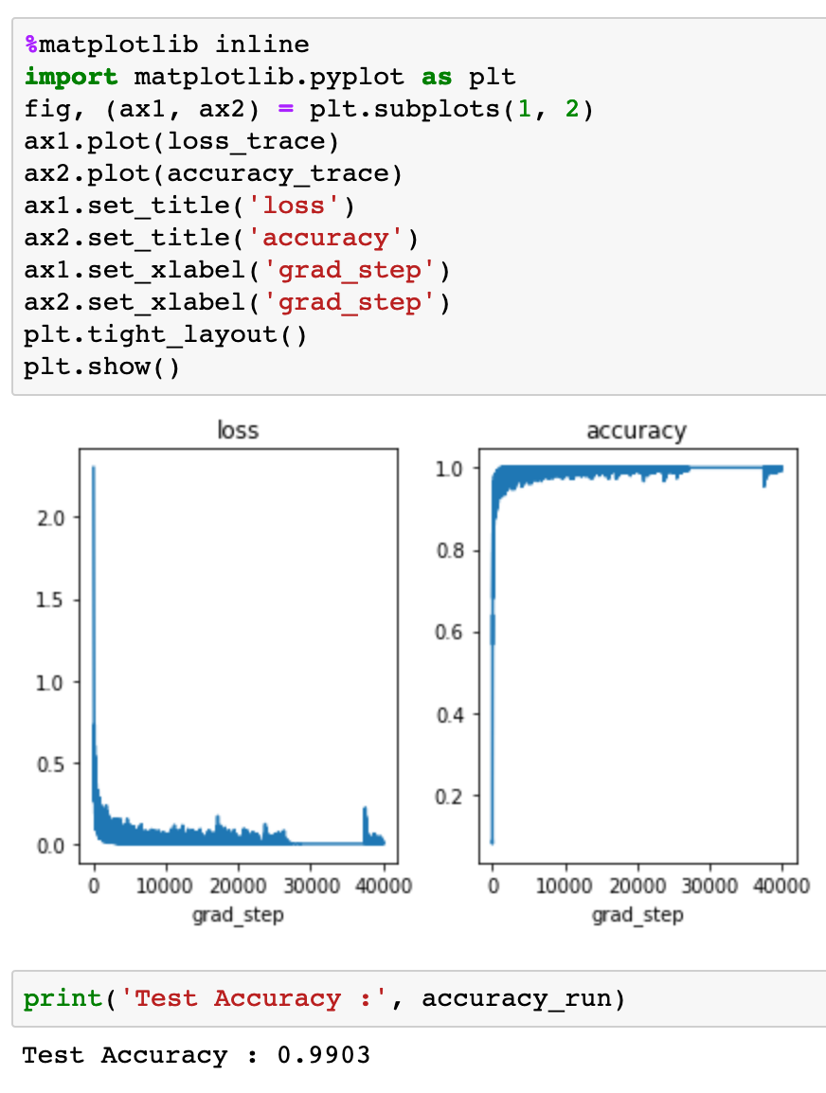
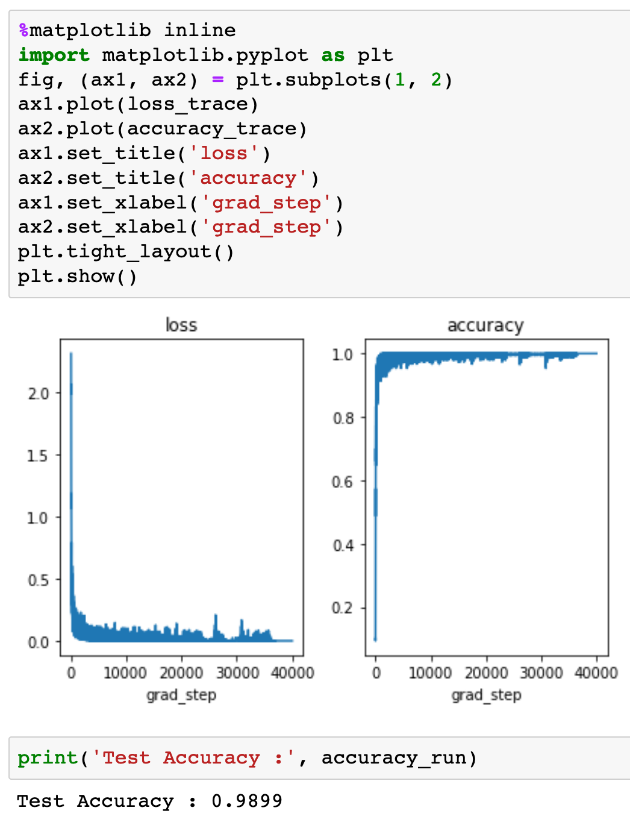
Without peepholes
With peepholes

Slide 33
Without peepholes
With peepholes

Slide 34
Without peepholes
With peepholes

Slide 35
Without peepholes
With peepholes

Slide 36
Without peepholes
With peepholes

Slide 37
Now
Let’s Play with Code

